Slide 1
Develop Language
Complete Sentences, Fragments, and Run-Ons

Slide 2
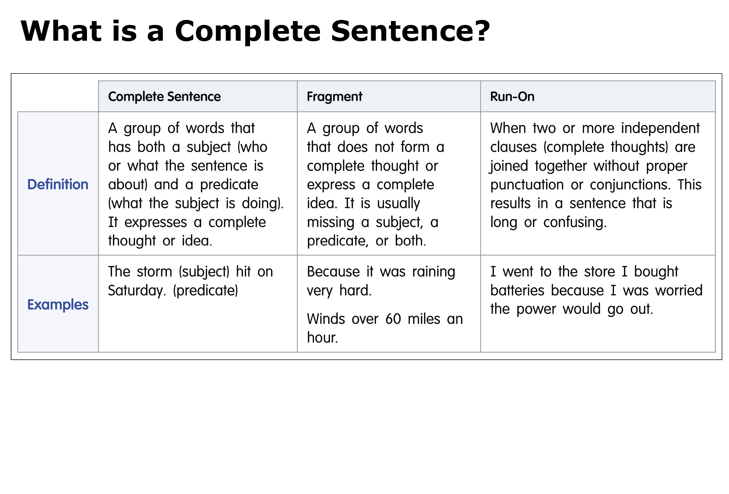


Collaborate
  What is the subject of the sentence?
  What is the predicate?
  Write a complete sentence about what you know about storms.
What is a complete sentence?
Learning Outcomes
  I will write a complete sentence.
Notes:
Complete Sentences
Let's review writing in complete sentences. Remember that writing in complete sentences helps you clearly convey your ideas to your readers.
Read aloud the definition of a complete sentence. Ask a student volunteer to read the example sentence aloud.
What is the subject of the sentence: who or what is the sentence about? (storm)
What is the predicate: what is the subject doing? (hit on Saturday)
Direct students to write their own complete sentences about what they know about storms or a type of weather.
ACCESS Ask Guiding Questions to support students as they write sentences about what they know about storms or a type of weather.
If students do not begin writing on their own, remind them that they should be writing a sentence to tell what they know about storms or a type of weather.
Prompt students with guiding questions:
What do you know about the topic?
What is needed to make your idea a complete sentence?
Jot students' oral response on a self stick note.
Have the student write the response.
Direct the student to write another sentence, this time about a type of weather.
Call on 2–3 student volunteers to share their complete sentences.

Slide 3

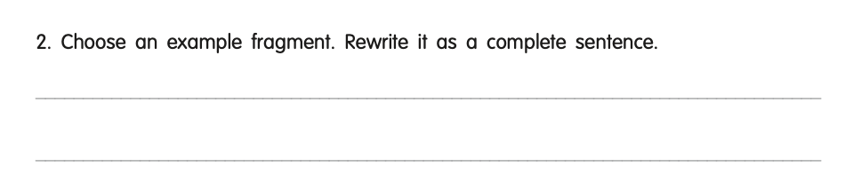
Collaborate
  Why are the first and second fragments not complete sentences?
  Choose one fragment and write it as a complete sentence.
What is a sentence fragment?
Learning Outcomes
  I will rewrite a fragment as a complete sentence.
    Teach
      Sometimes we use fragments when speaking, but we use complete sentences in writing.
Turn and Talk
  Listen
  Think
  Turn
  Talk
Notes:
Sentence Fragments
Read aloud the definition of a fragment.
Sometimes we use fragments when we're speaking, but we use complete sentences for our writing to express complete thoughts or ideas.
Ask a student volunteer to read aloud the first example fragment.
Have students use the Turn and Talk Protocol to answer this question:
Why are the first and second fragments not complete sentences?
Confirm that students understand that the first fragment only has a predicate and is missing a subject (who or what); the second fragment only has a subject and is missing a predicate (what the subject is doing).
Direct students to choose one of the fragment examples and rewrite it as a complete sentence on the lines provided for number 2.
Call on 2–3 student volunteers to share their complete sentences.

Slide 4

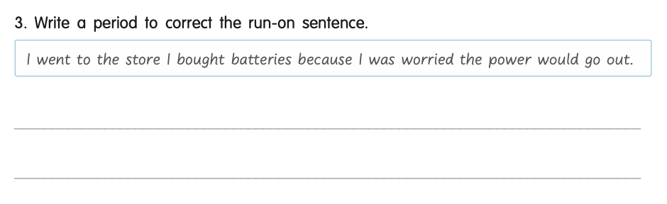
Collaborate
  Why is this sentence a run-on?
What is a run-on sentence?
Learning Outcomes
  I will rewrite a run-on sentence as complete sentences.
    Teach
        Decide where to add a period to make two complete sentences.
        See notes
Turn and Talk
  Listen
  Think
  Turn
  Talk
Notes:
Run-On Sentences
Read aloud the definition of a run-on sentence.
Ask a student volunteer to read aloud the example run-on sentence.
Have students use the Turn and Talk Protocol to answer this question:
Why is this sentence a run-on? (Sample response: This sentence is confusing because there are two sentences in a row without punctuation.)
Model for students where to add a period. Explain that adding a period after the first sentences now makes these two complete thoughts. Instruct students to add a period to the run-on sentence in the box for number 3.
Explain that in order to write in a way that readers understand, students must write in complete sentences. Fragments and run-ons can confuse readers and make it harder for them to understand your writing.

Slide 5
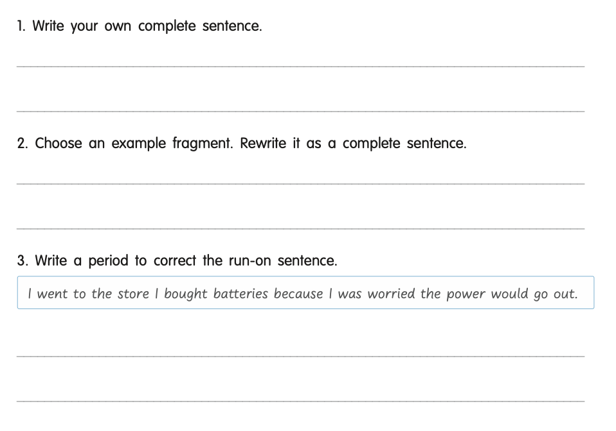
Storms can be very dangerous
Winds over 60 miles an hour blew over the tree.
I went to the store. I bought batteries because I
was worried the power would go out.
Notes:
Sample Responses

